Slide 1
Device Drivers

Slide 2
Linux Device Drivers
Linux supports three types of hardware device: character, block and network
  character devices: R/W without buffering
  block device : R/W via buffer cache
  Network device : BSD socket interface

Slide 3
Common Attributes of Devices Drivers
Kernel code
Kernel interface
Kernel mechanisms and services
Loadable : run time
Configurable: compile time
Dynamic : device may not exist

Slide 4
DMA
A DMA controller allows devices to transfer data to or from the system's memory without the intervention of the processor
Each DMA channel has associated with it a 16 bit address register and a 16 bit count register.

Slide 5
DMA
DMA controllers know nothing about VM
DMA controller cannot access the whole of physical memory
  only bottom 16M physical memory
DMA channels are scare resources : 7

Slide 6
Memory
Device drivers located in Linux kernel they cannot use virtual memory
Memory allocation shall be careful
Device driver may specify the allocated memory is DMA’able

Slide 7
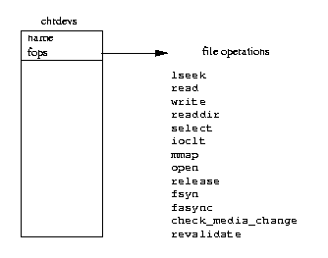
Interfacing Device Drivers with Kernel
Character Devices
Registered device driver

Slide 8
Interfacing Device Drivers with Kernel
Character Devices
  special file for a file system : /dev/cua0
  represented by a VFS inode
  it’s file operation are set to the default character device operations
Registered device driver

Slide 9
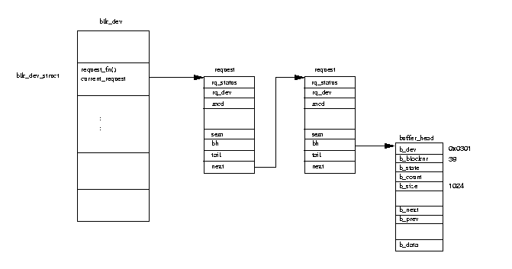
Interfacing Device Drivers with Kernel
Block Devices
Registered device driver

Slide 10
Interfacing Device Drivers with Kernel
Block Devices
  every block device must provide an interface to the buffer cache (as well as normal file operations)
  buffer cache R/W a block of data by adding a request data structure into blk_dev_struct
  the buffer_haed are locked
  Once the device driver has completed a request it must remove each of the buffer_head structures from the request structure
Registered device driver

Slide 11
Interfacing Device Drivers with Kernel
Block Devices
  mark the buffer-header up to date and unlock them
  wake up any process that has been sleeping waiting for the lock to complete
Registered device driver

Slide 12
Polling mode
The driver constantly interrogate the hardware
Waste of CPU time
Fastest way to communicate with the hardware

Slide 13
Interrupt Mode
For example, write a character to a parallel port:
  interruptible_sleep_on(&lp->lp_wait_q);
ISR handling the interrupt then wake up the process
  static void lp_interrupt(int irq){ wake_up(&lp->lp_wait_q);}

Slide 14
Interrupt Sharing
The number of IRQ’s in a PC is limited
PCI boards can be connect as interrupt sharing
Linux 2.0 support interrupt sharing by building chains of interrupt handling routins
When an interrupt occurs, each ISR in the chain is called by the do_IRQ()

Slide 15
Bottom halves
Not all the functions need to be performed immediately after an interrupt occurs
Others can be handled later or would take a relatively long time and it is preferable not to block the interrupt
Bottom halves
ret_from_syscall if no further interrupt in running at that time a list of up to 32 bottom halves is scanned

Slide 16
Implementing a driver
The setup function
Pass parameters to the drivers from LILO
Called before init();
Only set up global variables

Slide 17
Init()
Only called during kernel initialization
Test for the presence of a device
Generate internal device driver structures and register the device

Slide 18
open and release
open
  called as soon as a process opens a device file
  Initialize the standard setting of the device
release
  Called when the file descriptors for the device is released
  cleaning up activities

Slide 19
Read and Write
Reader/Writer Problem
Sleep/wake_up
memcopy_fromfs()
  interrupt may occur independently of the current process, data cannot be fetched from user area during the interrupt

Slide 20
IOCTL
Each device has it’s own characteristics,
  different operation mode and basic setting
ioctl usually change the variables global to the driver
Typical IOCTL call
  static int pcsp_ioctl( strruct inode *inode, struct file *file, usigned int cmd, unsign long arg)
  <linux/ioctl.h>
    macros for coding the individual commands

Slide 21
Select
Check whether data can be read from the device or written to it
It is important function for the character devices

Slide 22
lseek mmap
lseek : position (block devices)
mmap: map the device to the user address space (block devices)

Slide 23
readdir, fsync, fasync check_media_change revalidate
readdir, fsync, fasync
  for file systems only
check_media_change, revalidate
  for exchangeable media

